Slide 1

Kubernetes Threat Detection in Multiple Layers
KUBECON EUROPE 2024
Rodrigo Bersa
Liz Duke
WW Sr. Containers Specialist SA Amazon Web Services
WW Prin. Containers Specialist SA Amazon Web Services

Slide 2
Amazon GuardDuty

Slide 3
GuardDuty use cases
Assist security analysts in investigations and automate remediation
Detect and mitigate threats in your container environment
Improve security operations visibility
Identify files containing malware

Slide 4
Detect threats at each layer of Kubernetes
VPC Flow Logs and DNS logs continue to be monitored: defense in depth
GuardDuty EKS Protection
Amazon EKS control plane
(AWS CloudTrail)
Kubernetes control plane
(audit logs)
Container runtime
(system events)
Amazon EC2 nodes (malware protection)

Slide 5
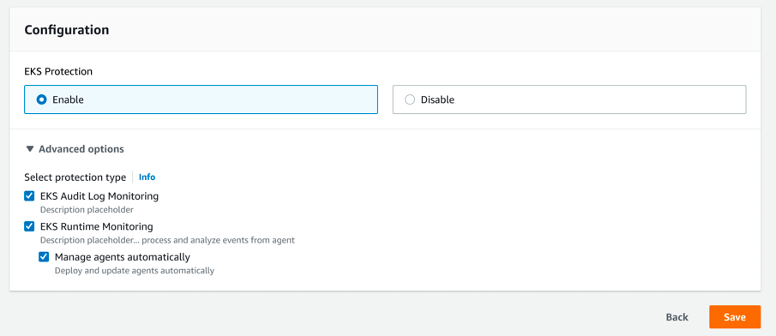
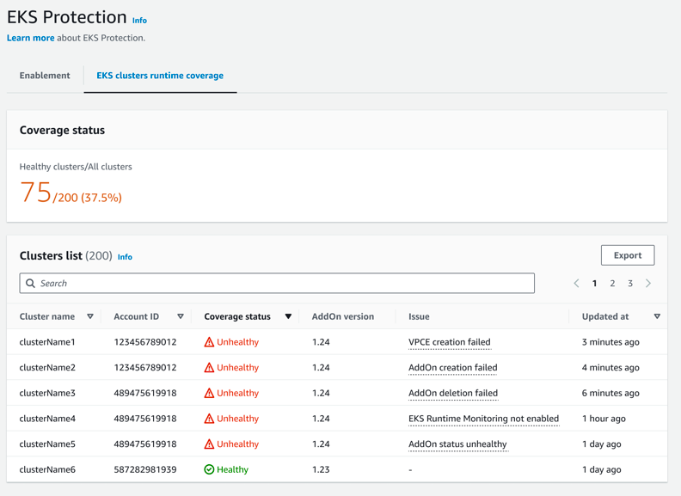
One-click enablement
Customize your Kubernetes protection with simple check boxes for Log and Runtime Monitoring.
Monitor all your clusters coverage status in one single view.

Slide 6
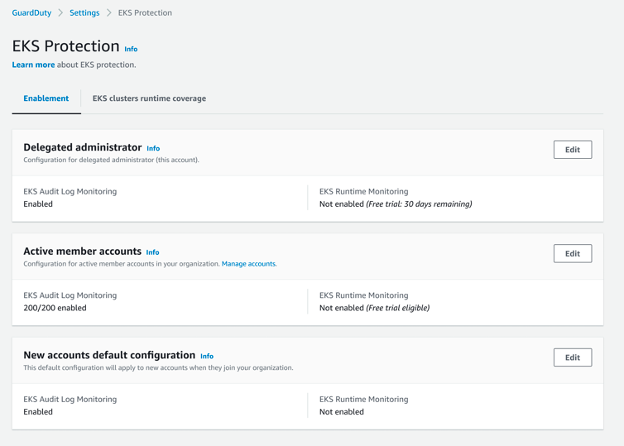
Simplified organization-wide coverage
Enable centralized administration with one-click!
Manage member accounts.
Apply GuardDuty definitions on every Amazon EKS Cluster from the Delegated Administrator account

Slide 7
EKS Audit Log Monitoring
Policy
Malicious access
Suspicious behavior
Exposed dashboard
Admin access to default service account
Anonymous access granted
Data discovery, exfiltration, or modification from:
Tor
Successful anonymous access
Malicious IPs
Execution in Kubernetes system pod
Container with sensitive mount
Privilege container
GuardDuty immediately begins to analyze Kubernetes data sources from your Amazon EKS clusters and monitors them for malicious and suspicious activity.
GuardDuty aligns findings using the MITRE ATT&CK framework
Credential Access
Defense Evasion
Discovery
Impact
Privilege Escalation
Policy
Execution
Persistence

Slide 8


EKS Runtime Monitoring
Impact
Finding types
Execution
Crypto Currency
Backdoor
Amazon Elastic Kubernetes Service (Amazon EKS)
Amazon GuardDuty
Unauthorized Access
Privileged Escalation
Unauthorized Access

Slide 9
EKS Runtime Monitoring
Impact
Finding types
Impact
Impact:Runtime/AbusedDomainRequest.Reputation
Impact:Runtime/BitcoinDomainRequest.Reputation
Impact:Runtime/MaliciousDomainRequest.Reputation
Impact:Runtime/SuspiciousDomainRequest.Reputation
Impact:Runtime/CryptoMinerExecuted
Amazon Elastic Kubernetes Service (Amazon EKS)
Amazon GuardDuty

Slide 10
EKS Runtime Monitoring
Finding types
Execution
Execution
Execution:Runtime/NewBinaryExecuted
Execution:Runtime/NewScriptExecuted
Execution:Runtime/NewLibraryLoaded
Execution:Runtime/ReverseShell
Amazon Elastic Kubernetes Service (Amazon EKS)
Amazon GuardDuty

Slide 11
EKS Runtime Monitoring
Finding types
Crypto Currency
CryptoCurrency
CryptoCurrency:Runtime/BitcoinTool.B!Dns
CryptoCurrency:Runtime/BitcoinTool.B
Amazon Elastic Kubernetes Service (Amazon EKS)
Amazon GuardDuty

Slide 12
EKS Runtime Monitoring
Finding types
Backdoor
Amazon Elastic Kubernetes Service (Amazon EKS)
Amazon GuardDuty
Backdoor
Backdoor:Runtime/C&CActivity.B!Dns
Backdoor:Runtime/C&CActivity.B

Slide 13
EKS Runtime Monitoring
Finding types
UnauthorizedAccess
UnauthorizedAccess:Runtime/TorRelay
UnauthorizedAccess:Runtime/TorClient
Amazon Elastic Kubernetes Service (Amazon EKS)
Amazon GuardDuty
Unauthorized Access

Slide 14
EKS Runtime Monitoring
Finding types
PrivilegeEscalation
PrivilegeEscalation:Runtime/ContainerMountsHostDirectory
PrivilegeEscalation:Runtime/DockerSocketAccessed
PrivilegeEscalation:Runtime/RuncContainerEscape
PrivilegeEscalation:Runtime/CGroupsReleaseAgentModified
Amazon Elastic Kubernetes Service (Amazon EKS)
Amazon GuardDuty
Privilege Escalation

Slide 15
EKS Runtime Monitoring
Finding types
Trojan
Trojan:Runtime/BlackholeTraffic
Trojan:Runtime/DropPoint
Trojan:Runtime/BlackholeTraffic!Dns
Trojan:Runtime/DropPoint!Dns
Trojan:Runtime/DGADomainRequest.C!DNS
Trojan:Runtime/DriveBySourceTraffic!DNS
Trojan:Runtime/PhishingDomainRequest!DNS
Amazon Elastic Kubernetes Service (Amazon EKS)
Amazon GuardDuty
Trojan

Slide 16
EKS Runtime Monitoring
Container Details
Process Details
Kubernetes Pod Details
Container ID
Container image
Container name
Process ID
Executable path
Parent PID
Executable SHA-256 hash
User ID
Effective user ID
Process lineage (all ancestors of the process)
Pod ID
Pod name
Pod namespace

Slide 17
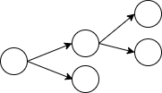

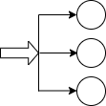

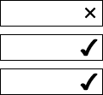

EKS Runtime Monitoring
High level architecture
eBPF based agent is deployed as EKS Addon
Agent collects and sends events via VPC endpoint
GuardDuty backend processes events
Stateful rules
Agent
Ingest events
Apply threat intel
Stateless rules
Machine learning

Slide 18




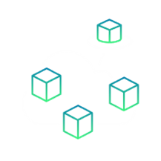

GuardDuty Malware Protection
Delivers agentless detection of malware on AWS workloads
Single-click organization-wide malicious file detection
Centralized monitoring, automation, and investigation
Contextualized findings to validate suspicious behavior
No agents to install, update, or maintain
Container-aware
No performance impact or hidden Amazon EC2 costs for scanning

Slide 19



GuardDuty Malware Protection
Coverage
Amazon Elastic Compute Cloud (Amazon EC2)
Amazon Elastic Kubernetes Service (Amazon EKS)
Amazon Elastic Container Service (Amazon ECS)
Self-managed containers on Amazon EC2
Automatically trigger scans for potential threats when suspect activity is detected. Standard EC2 scans once every 24 hours

Slide 20
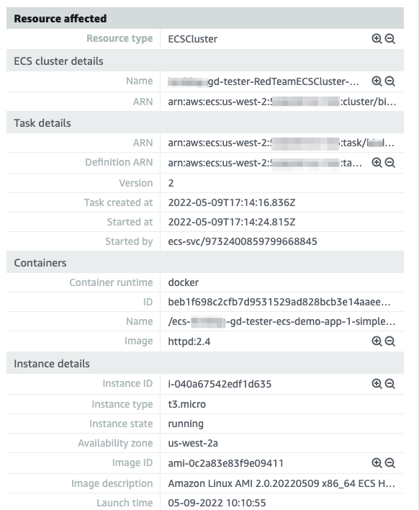
GuardDuty Malware Protection
Investigate the exact container that is compromised
Dive deep with granular reports allowing users to track findings across Containers, Tasks/Pods, Nodes and Clusters.

Slide 21
Demo

Slide 22


Slide 23


Get started
Get started with Amazon GuardDuty Learn more about accurate, account-level threat detection, optimized for cloud, and try for 30 days at no cost! You will receive full access to GuardDuty features and its detection findings during the free trial.
AWS GuardDuty Terraform Terraform module that leverages Infrastructure-as-Code (IaC) automation pipelines to create AWS GuardDuty resources.

Slide 24
Thank you
Rodrigo Bersa
Liz Duke
bersr@amazon.com
linkedin.com/in/bersa
lizduke@amazon.co.uk linkedin.com/in/liz-duke

Slide 25
Appendix

Slide 26
Amazon Detective

Slide 27



Detective benefits
Analyze and visualize security data to investigate potential security issues
Determine potential security issues through a unified view
Save time and effort with graph models that summarize security relationships in AWS
Investigate and respond to security findings with streamlined visualizations
Notes:
1. Using a unified view makes it easier to identify patterns that may validate or refute a security issue, and to understand all of the resources impacted by the security finding.
2. With the geolocation map, users can view login attempts, drill down into relevant historical activities, quickly determine a root cause and, if necessary, take action to resolve the further issue.
3. The graph model is prebuilt with the security-related relationships and summarizes contextual, and behavioral insights, which enable users to quickly validate, compare and correlate the data to reach conclusions. Amazon Detective’s visualizations are powered by the graph model enabling users to rapidly answer their investigative questions without the complexity of querying raw logs. For example, the graph provides the context and relationships around when an IP address is connected to an EC2 instance, and then the API calls that a role has issued in the specific time.

Slide 28






Security behavior graph
connected
detected
assigned
IP address
EKS pod
GuardDuty finding
attached
used
EC2
found
user agent
assumed
Inspector finding
IAM role
IAM user
Notes:
In Amazon Detective, you conduct investigations using data from a Detective behavior graph. A behavior graph is a linked set of data generated from the Detective source data that is ingested from one or more Amazon Web Services (AWS) accounts. The behavior graph uses the source data to do the following:
Generate an overall picture of your systems, users, and the interactions among them over time offering a streamlined, holistic view
Perform more detailed analysis of specific activity to help you answer questions that arise as you conduct investigations
Correlate collections of findings, entities, and evidence that may be related to the same event or security issue
Note that all extraction, modeling, and analytics of behavior graph data occurs within the context of each individual behavior graph. As new data comes in, Detective uses a combination of extraction and analytics to populate the behavior graph. Extraction is based on configured mapping rules. A mapping rule basically says, "Whenever you see this piece of data, use it in this specific way to update behavior graph data.” For example, an incoming Detective source data record might include an IP address. If it does, Detective uses the information in that record to create a new IP address entity or update an existing IP address entity.

Slide 29
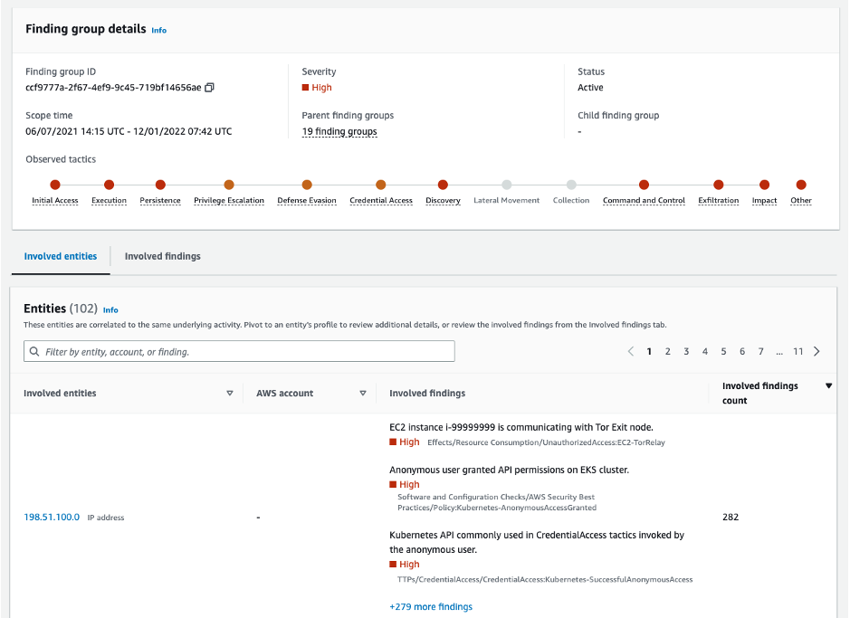
Determine Potential Security Issues
Unified view of user and resource interactions
Maps the evolution of findings to tactics, techniques, and procedures (TTP) from the MITRE ATT&CK framework
Groups all involved entities and findings into a single group to better understand the impact of a potential security event

Slide 30
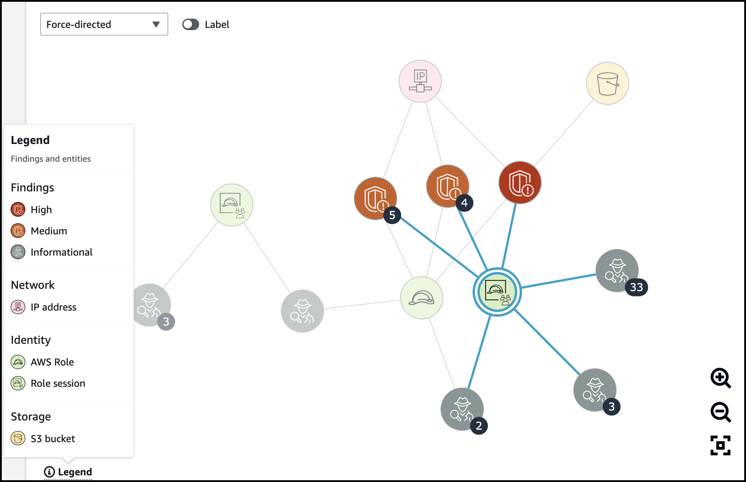
Summarize Security Relationships
Save time and effort with finding groups
Visualize findings and affected entities with an interactive menu that allows better representation of events
Investigate all details, context, and historical activities in one place to determine the root cause

Slide 31
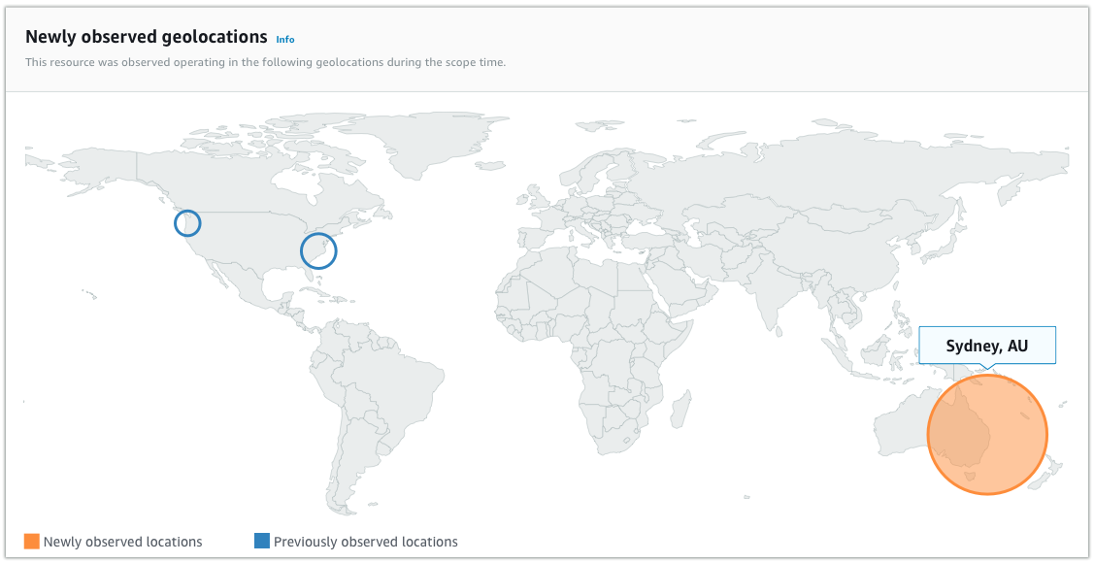
Investigate and Respond
security findings with streamlined visualizations
Helps identify suspicious and anomalous events by baselining normal activity like API calls, inbound / outbound volume, and Kubernetes pods
Shows activity coming from newly observed locations, newly observed API calls, normal traffic volume, to help identify unusual activity

